Slide 1

Image Segmentation
jaime.barranco@hes-so.ch
Jaime Barranco
03.03.2025

Slide 2
Structure
Introduction
Threshold-based segmentation
Histogram extrema
Otsu’s method
K-means algorithm
Optimal thresholding
Histogram estimation
Enhancing threshold segmentation
Morphology
Local thresholding
Edge-based segmentation
Edge linking
Watershed segmentation
Active contours

Slide 3
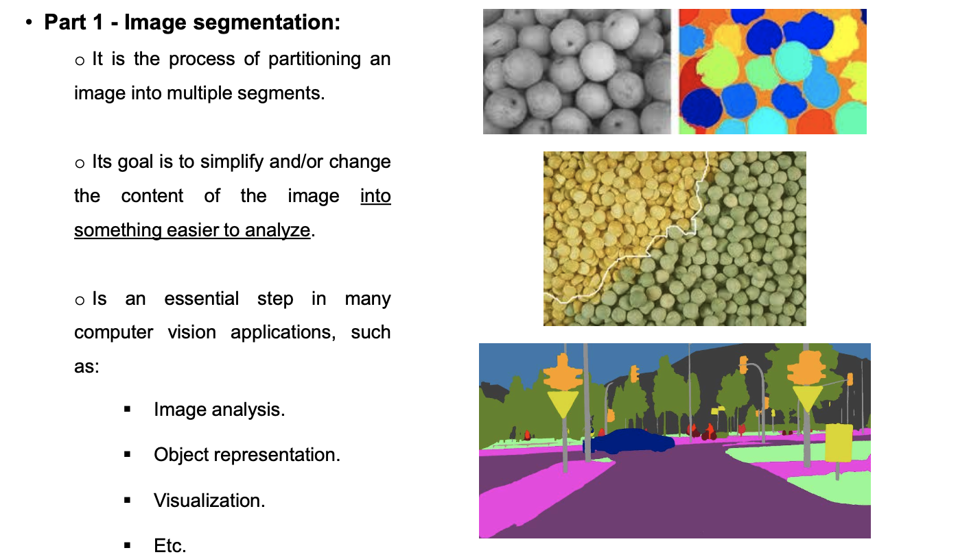
1. Introduction

Slide 4
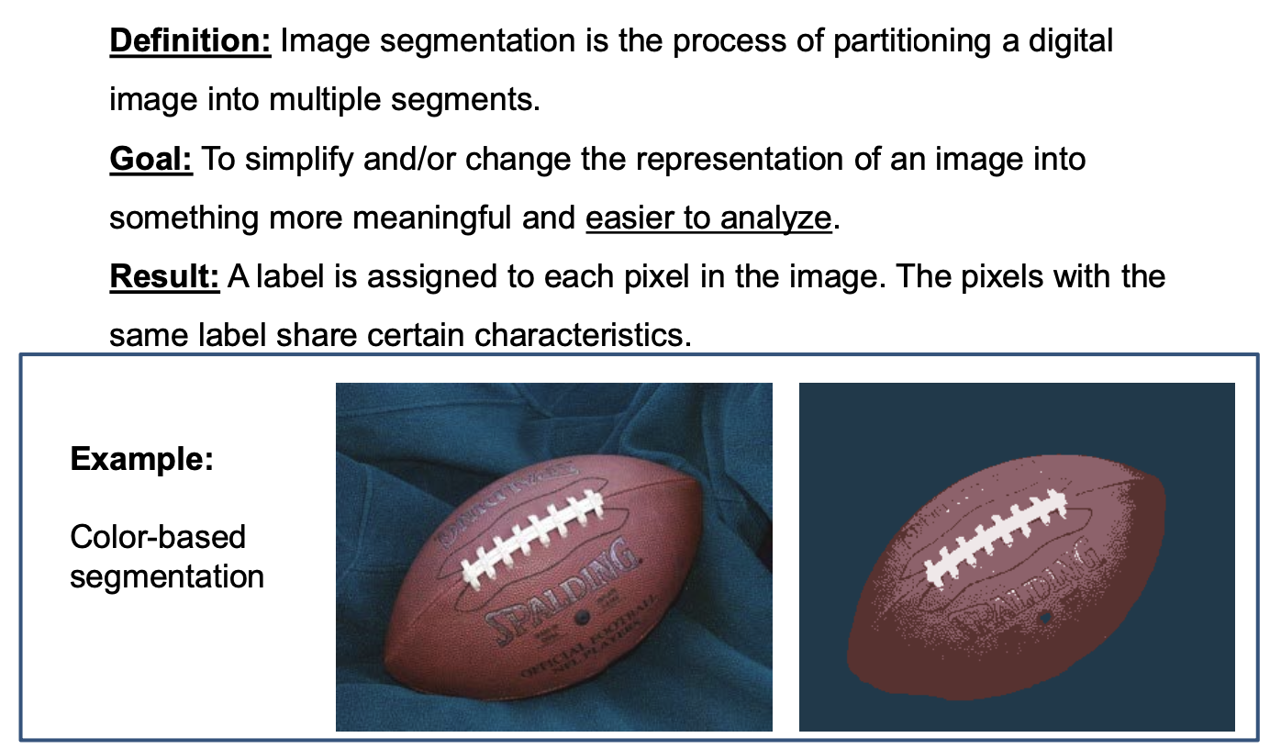
1. Introduction

Slide 5
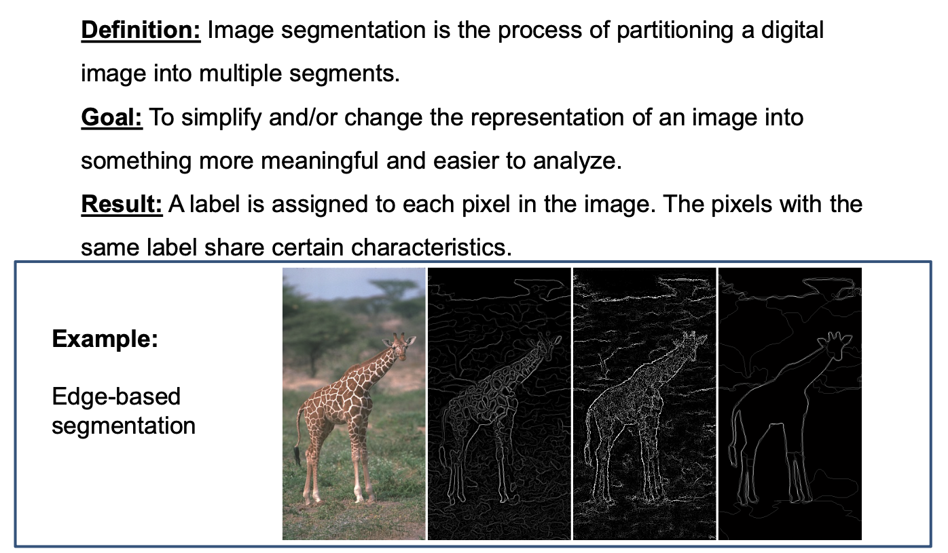
1. Introduction

Slide 6
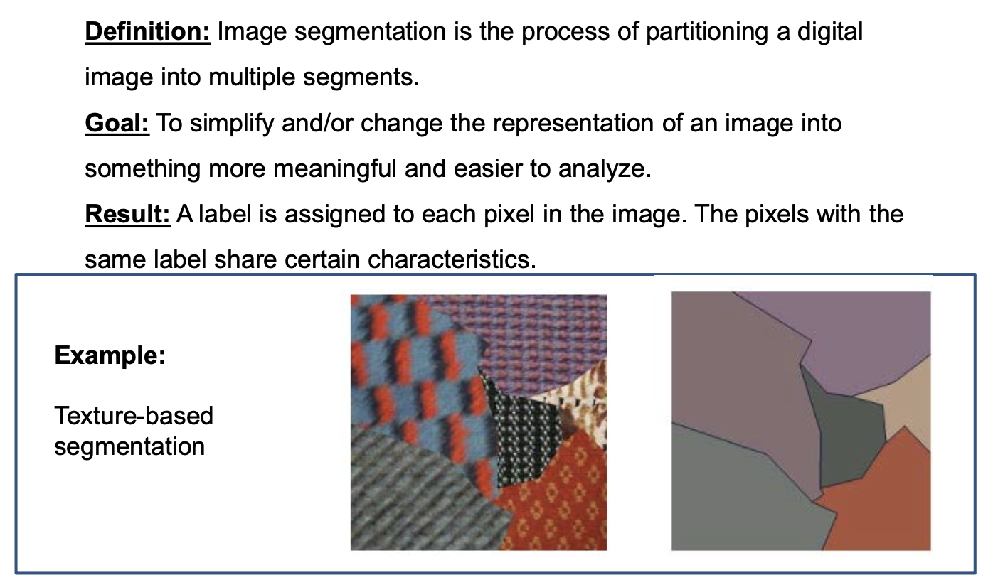
1. Introduction

Slide 7
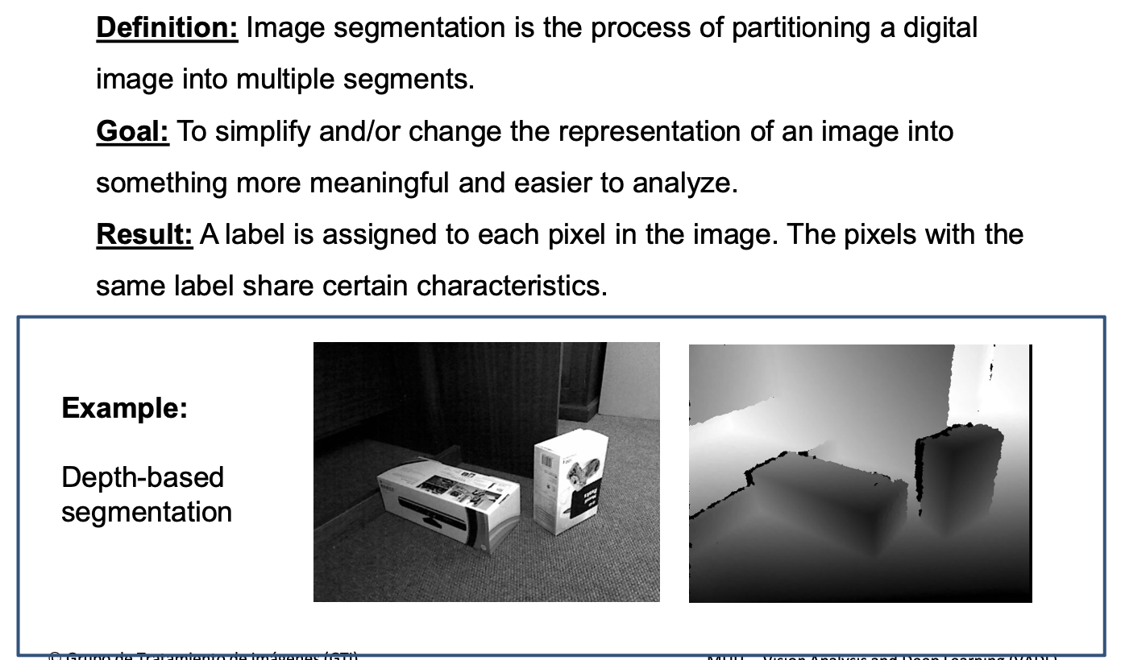
1. Introduction

Slide 8
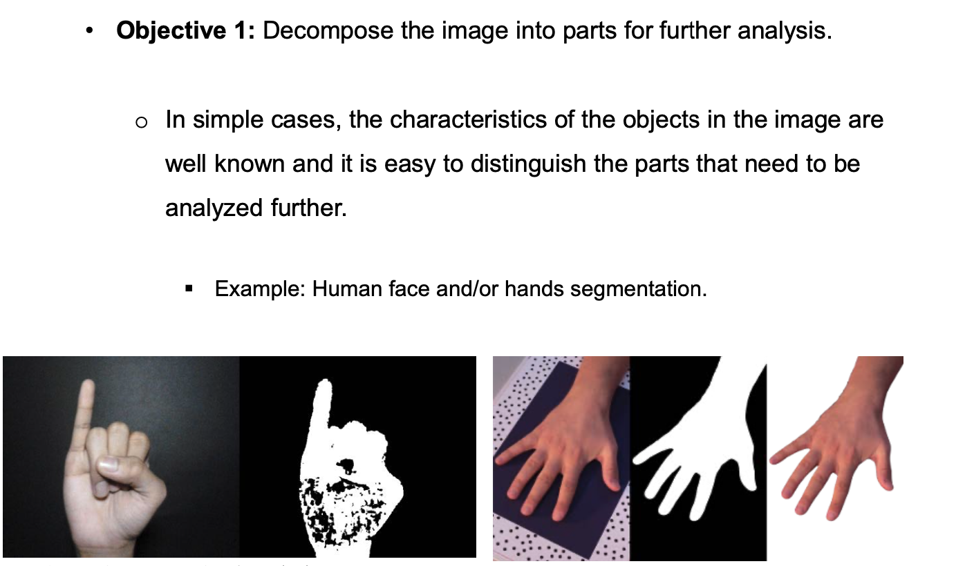
1. Introduction

Slide 9
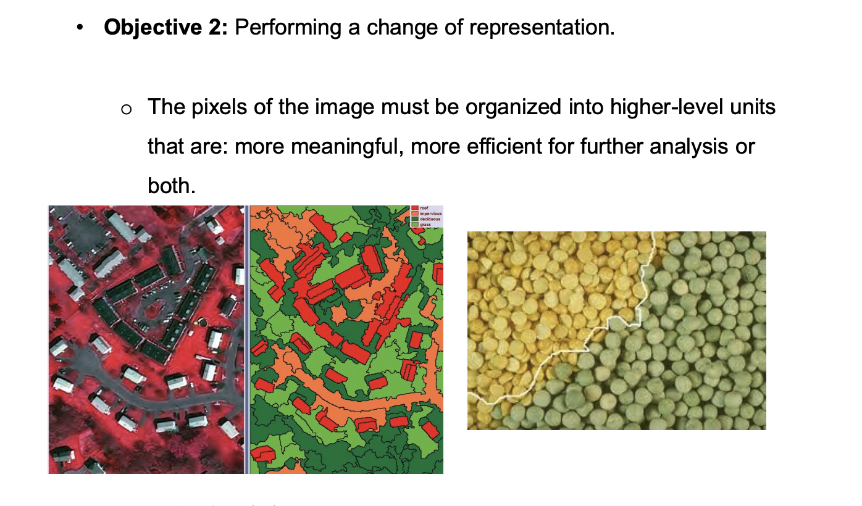
1. Introduction

Slide 10
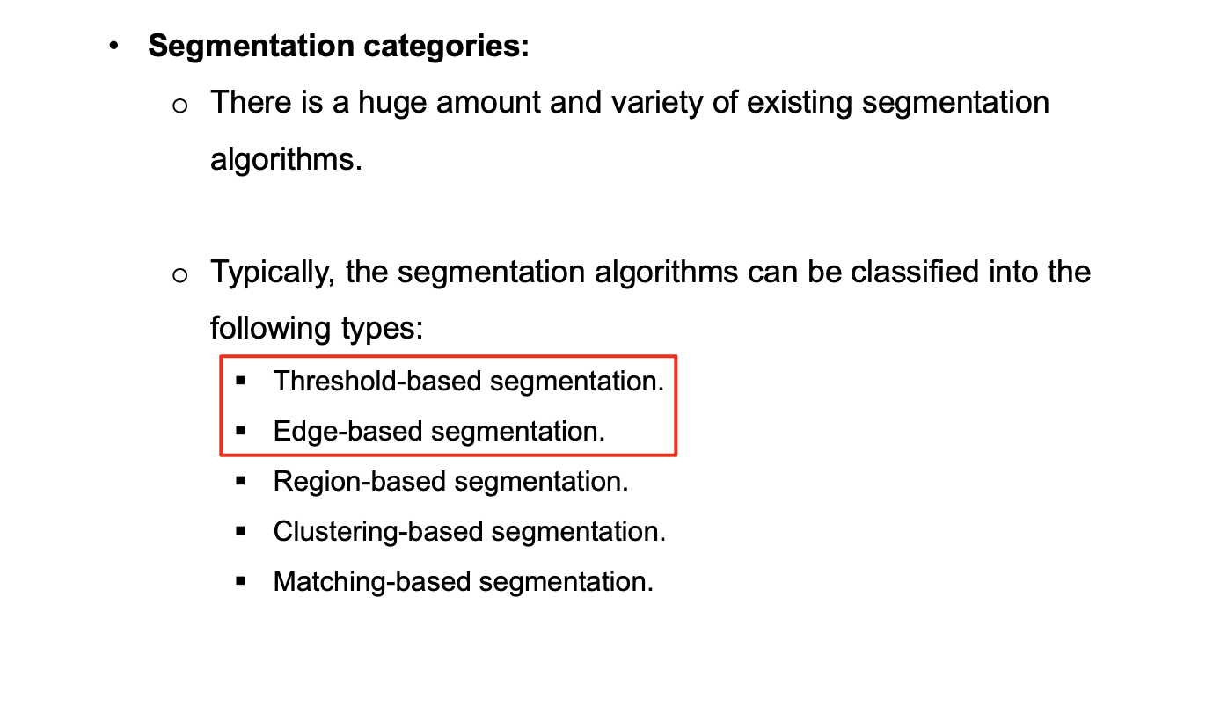
1. Introduction

Slide 11
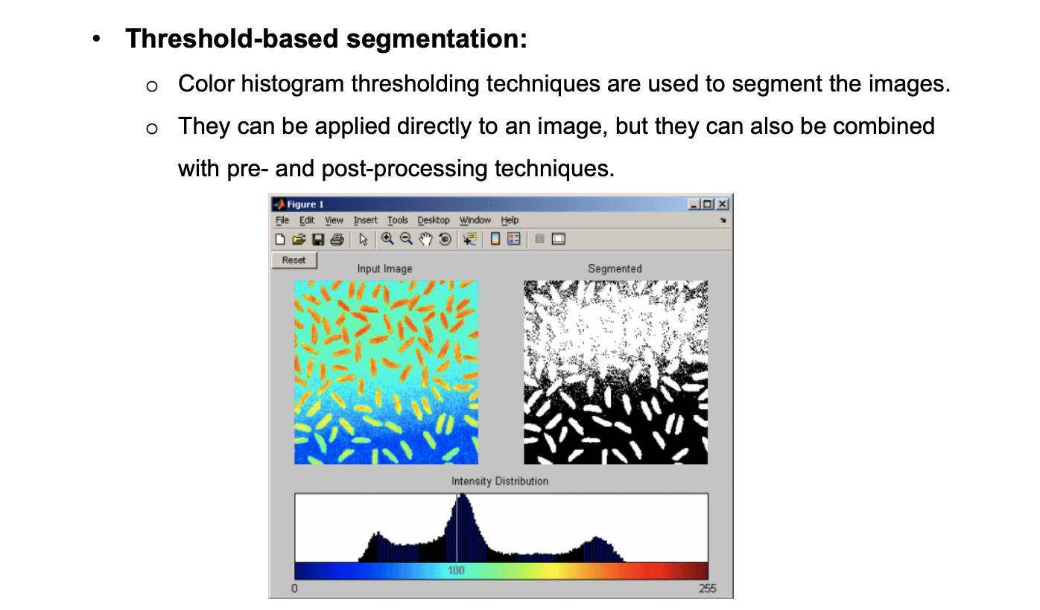
1. Introduction

Slide 12
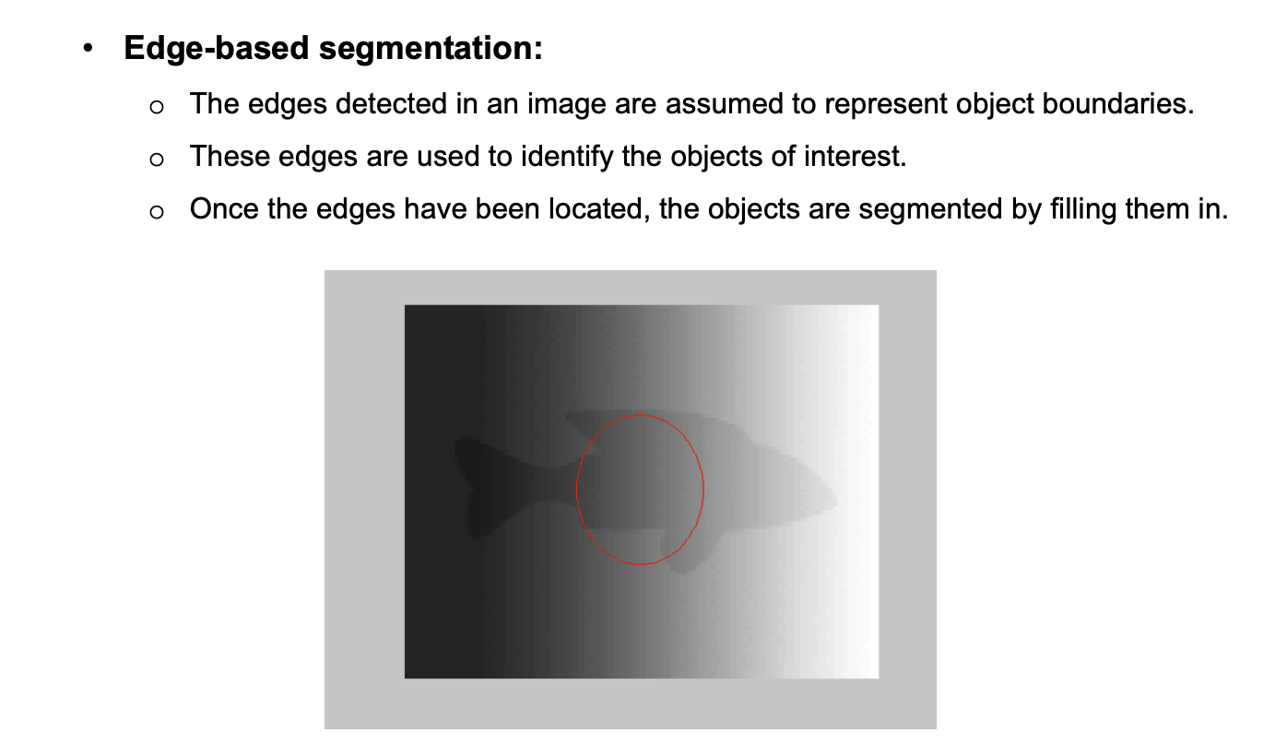
1. Introduction

Slide 13
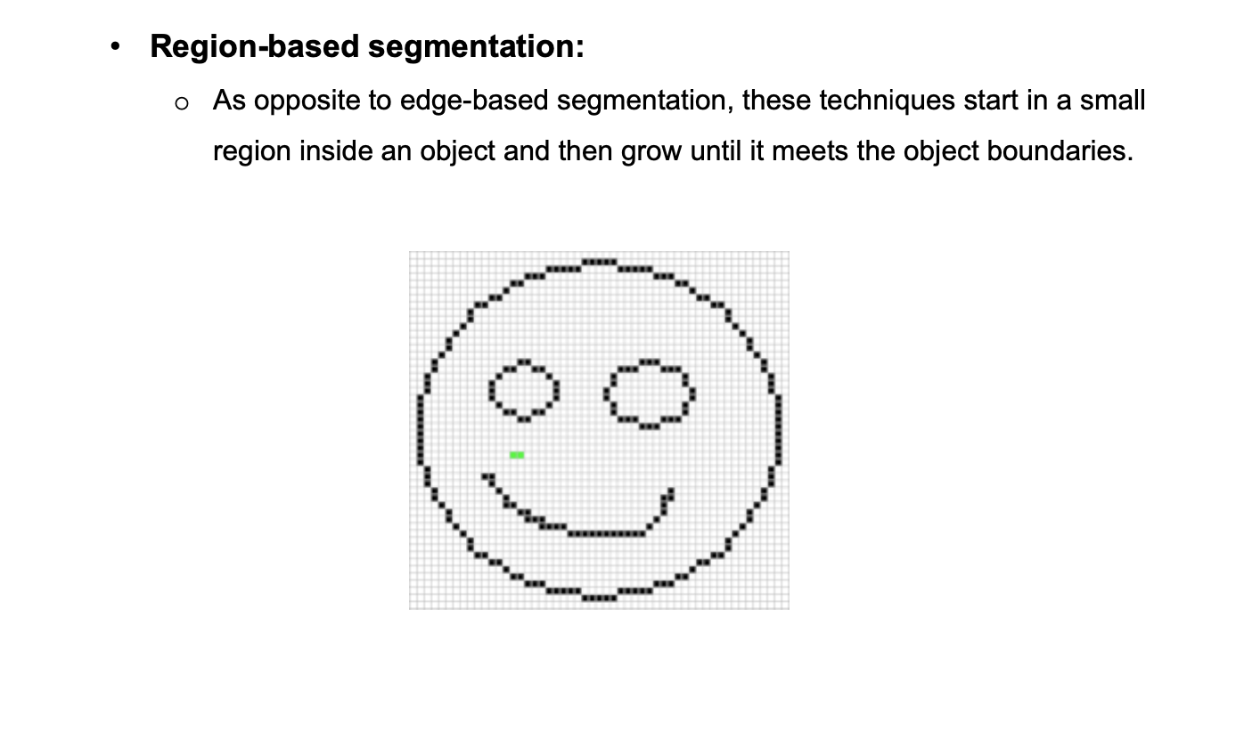
1. Introduction

Slide 14
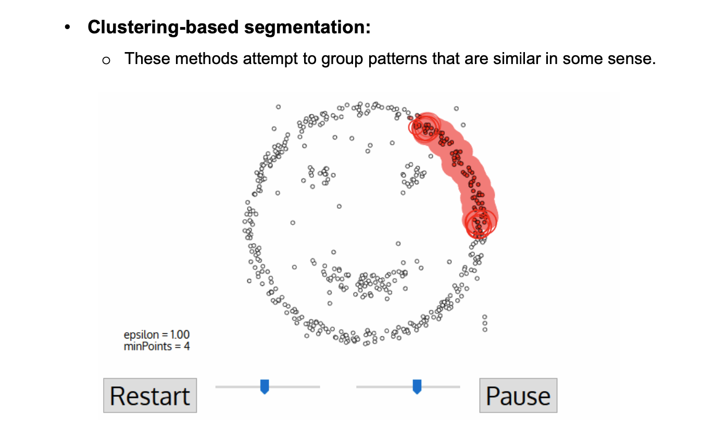
1. Introduction

Slide 15
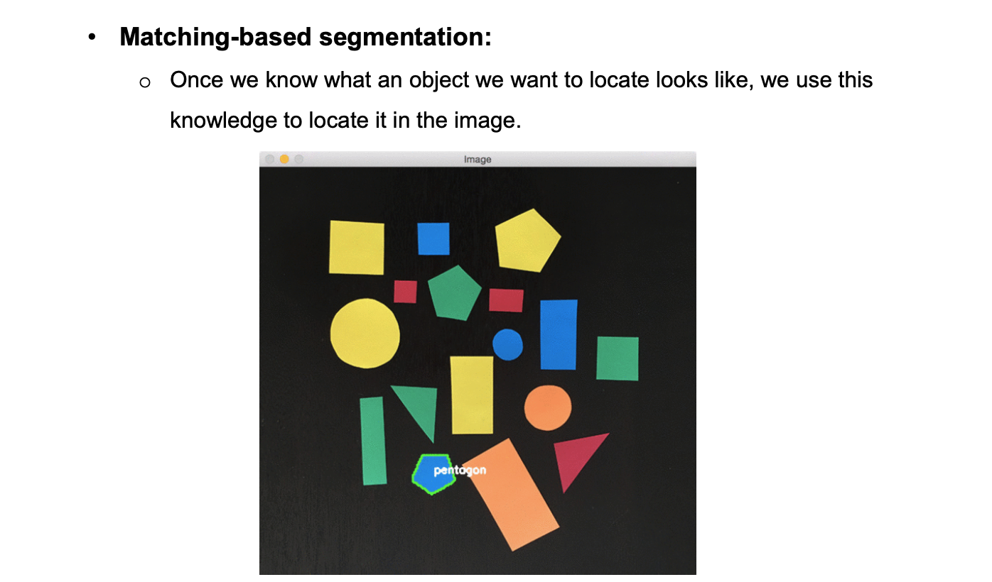
1. Introduction

Slide 16
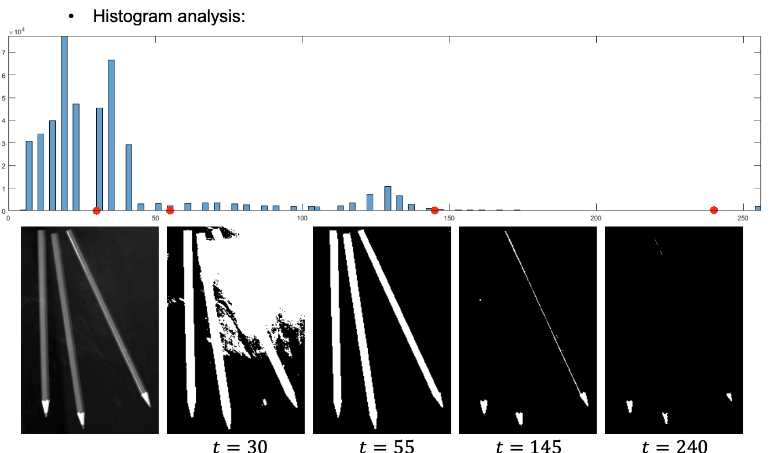
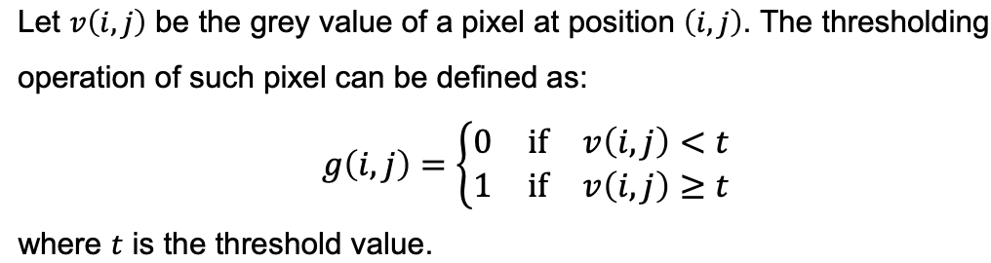
2. Threshold-based segmentation

Slide 17
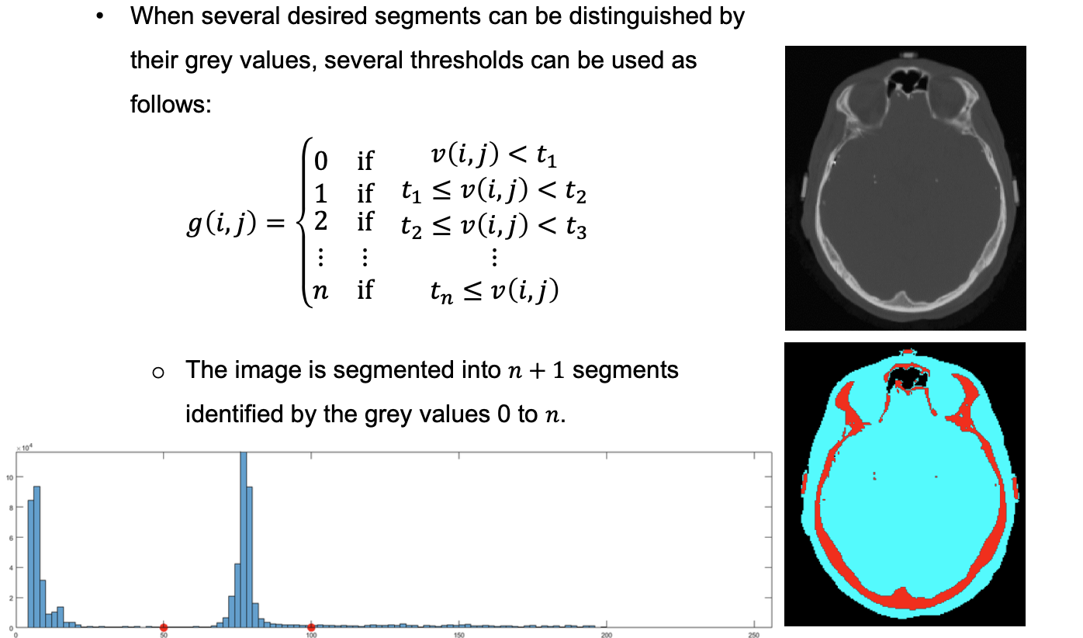
2. Threshold-based segmentation

Slide 18
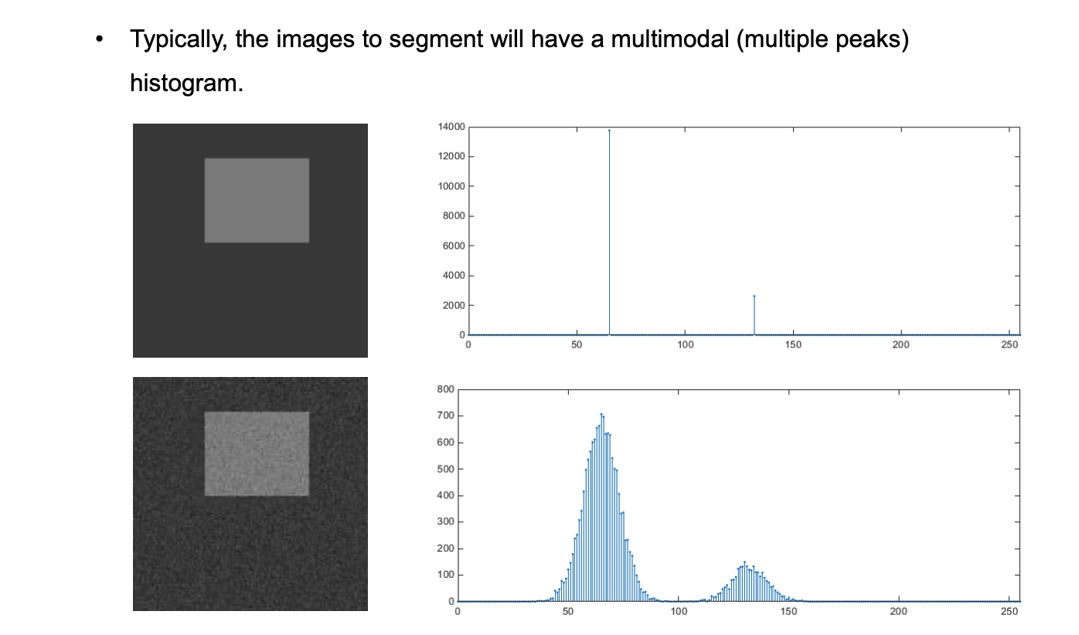
2.1. Histogram extrema

Slide 19
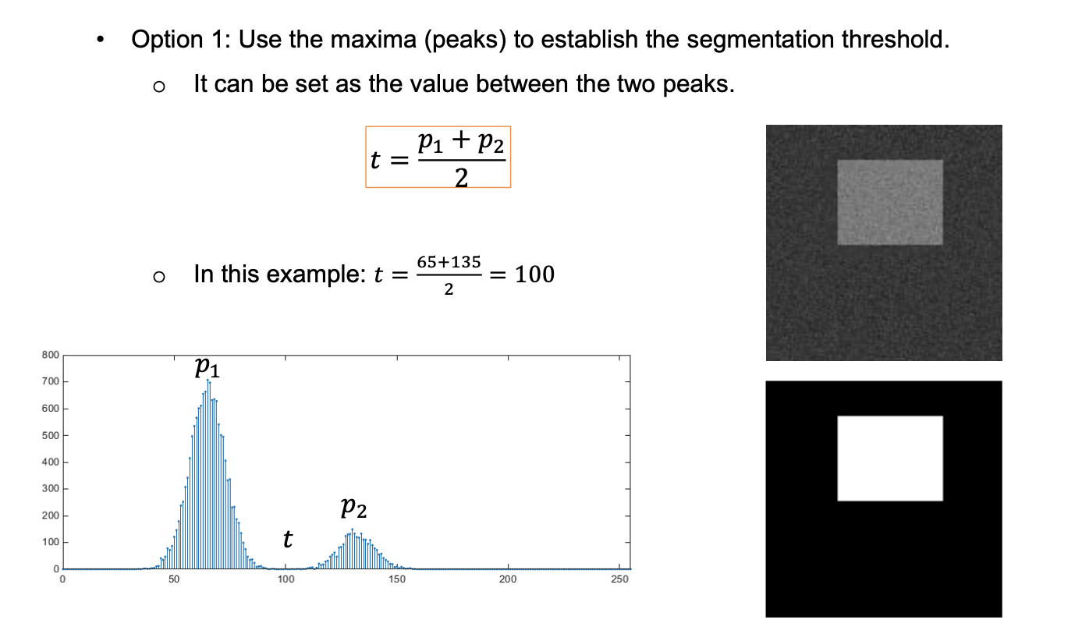
2.1. Histogram extrema

Slide 20
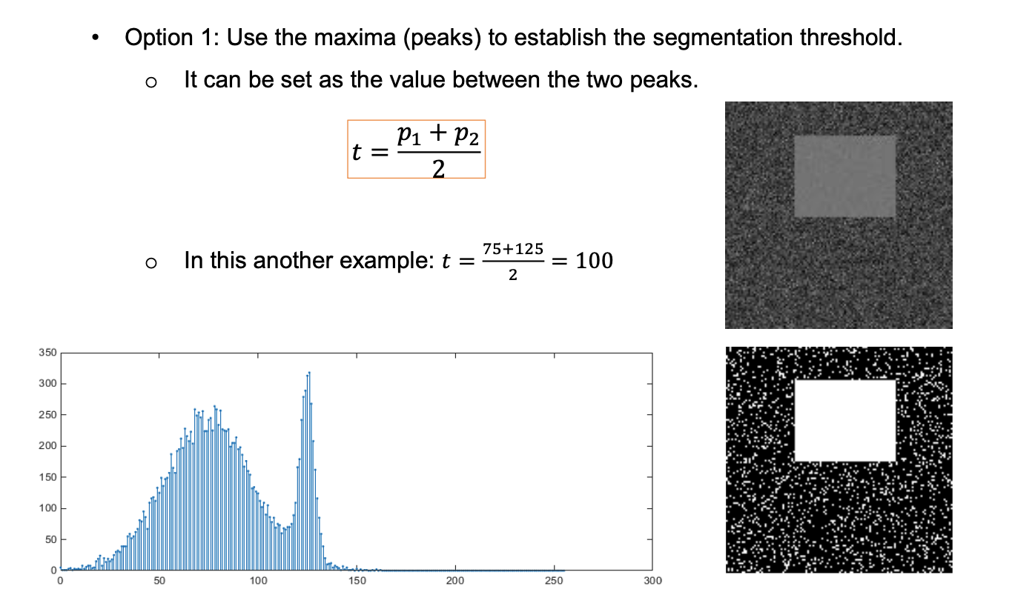
2.1. Histogram extrema

Slide 21
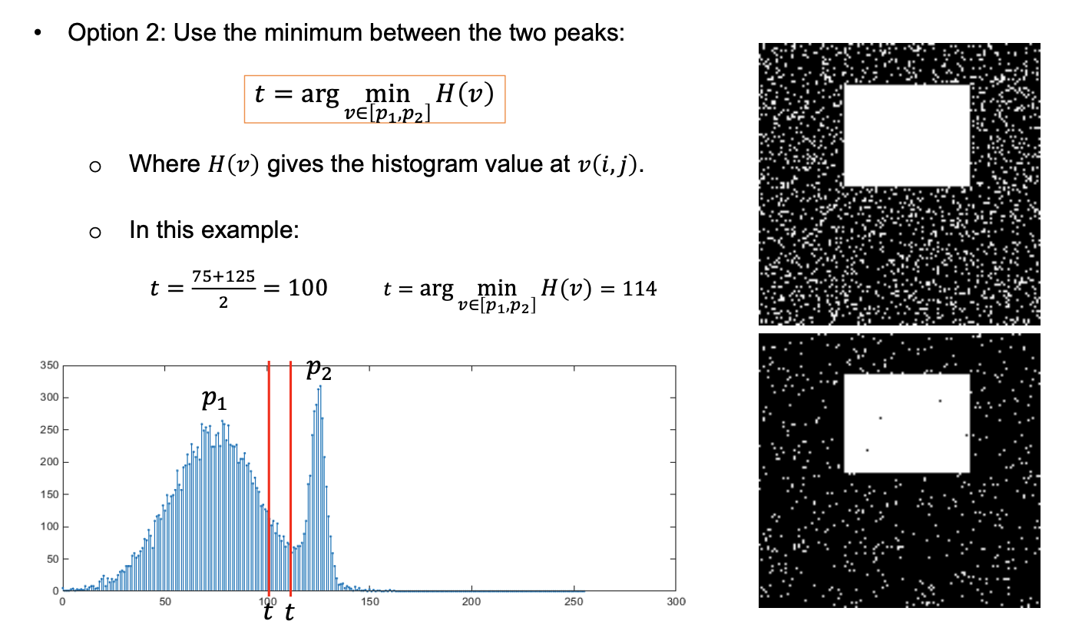
2.1. Histogram extrema

Slide 22
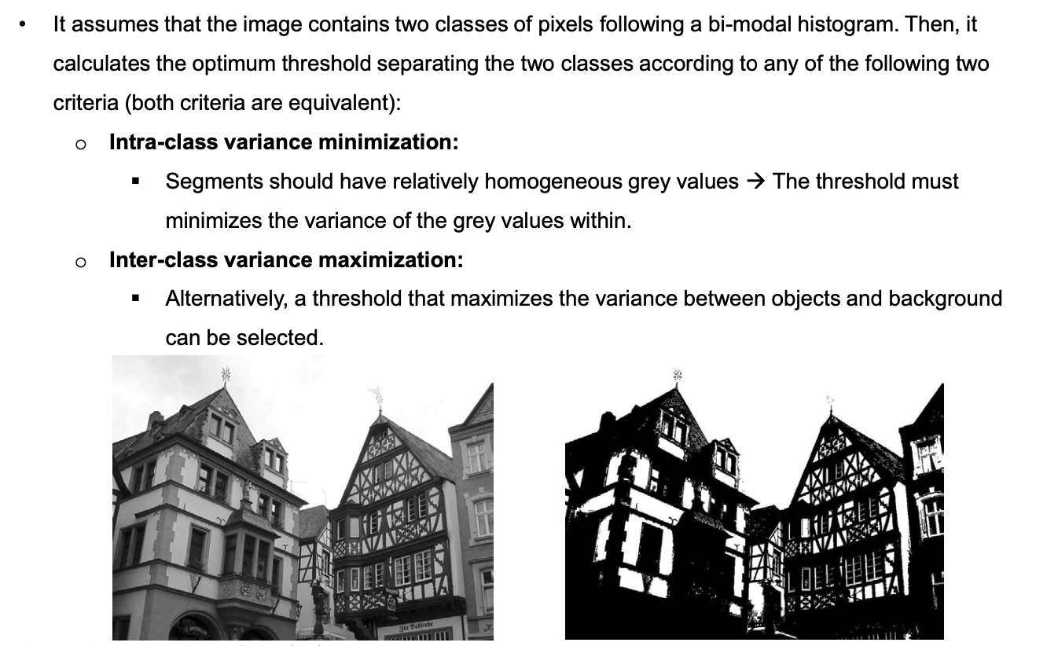
2.2. Otsu’s method

Slide 23
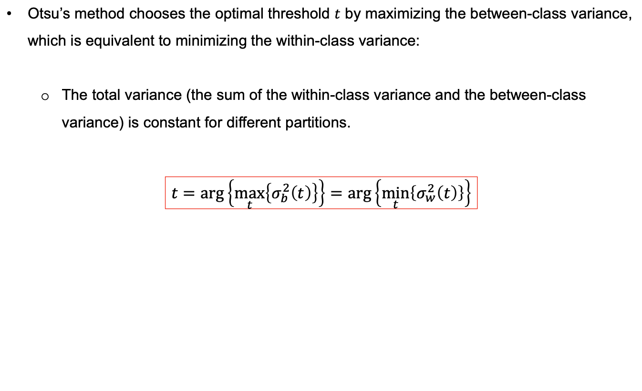
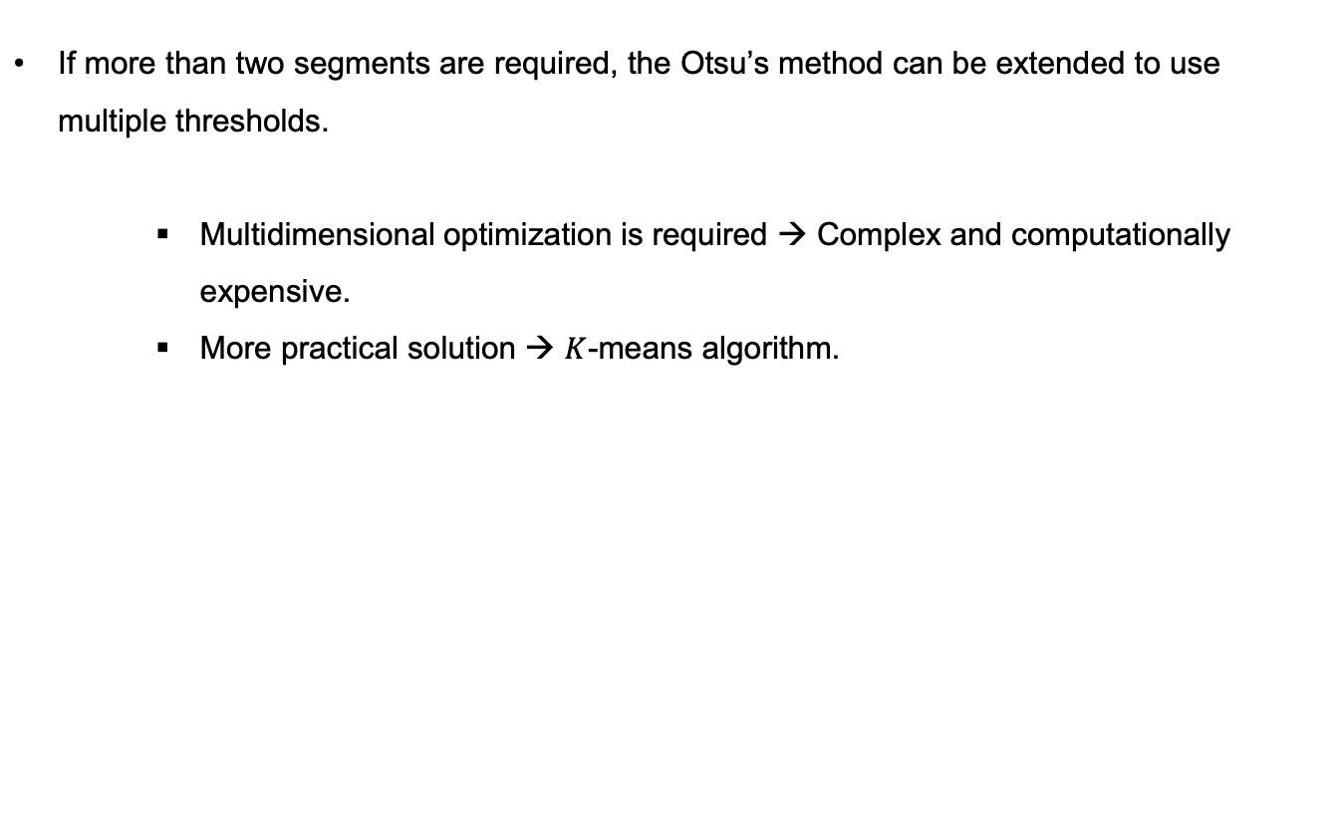
2.2. Otsu’s method

Slide 24
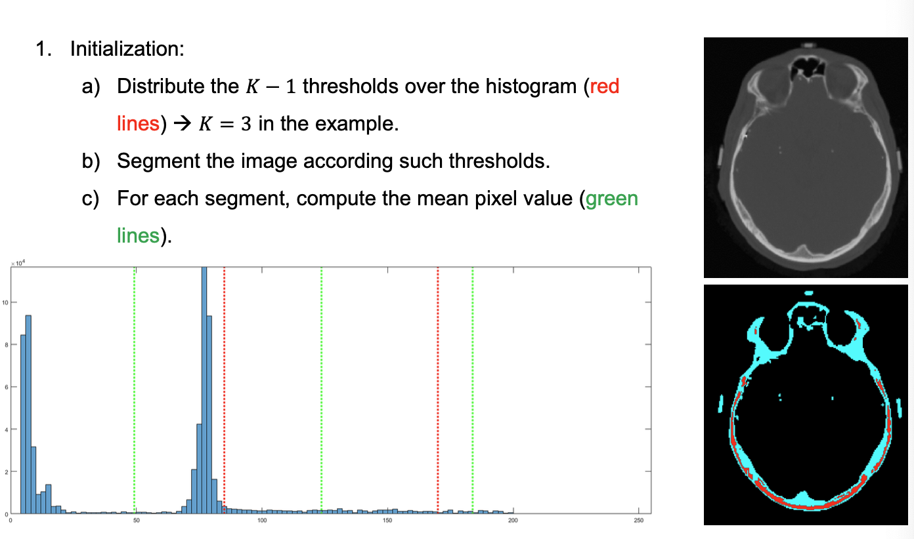
2.3. K-means algorithm

Slide 25
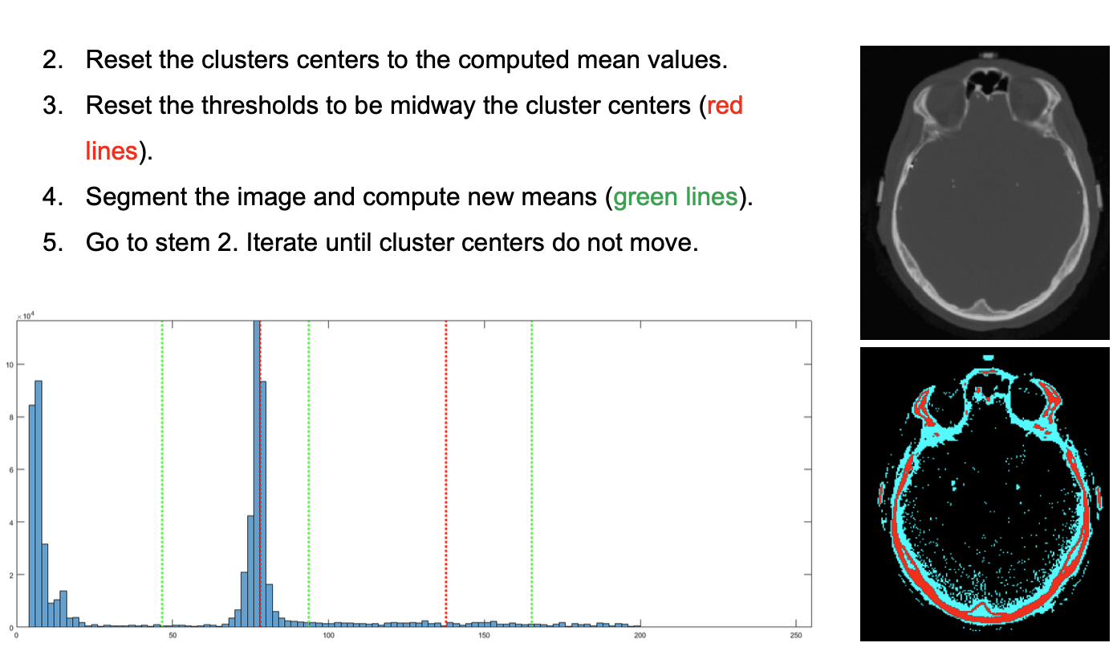
2.3. K-means algorithm

Slide 26
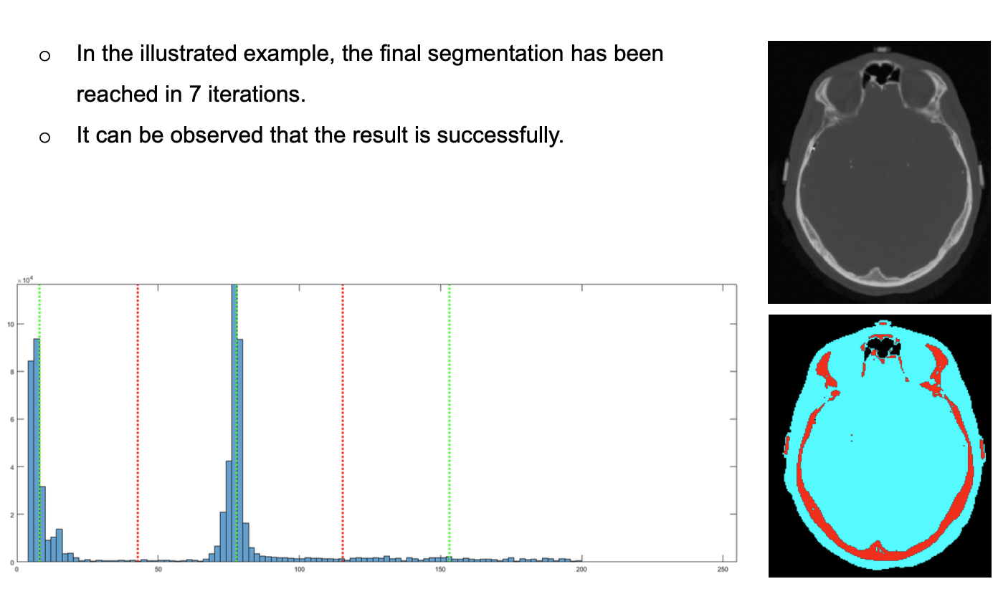
2.3. K-means algorithm

Slide 27
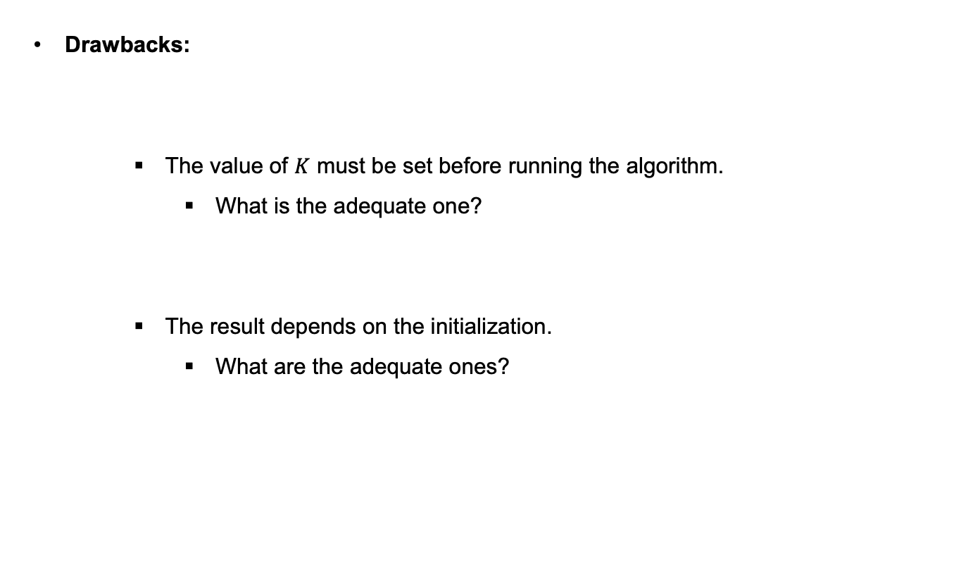
2.3. K-means algorithm

Slide 28
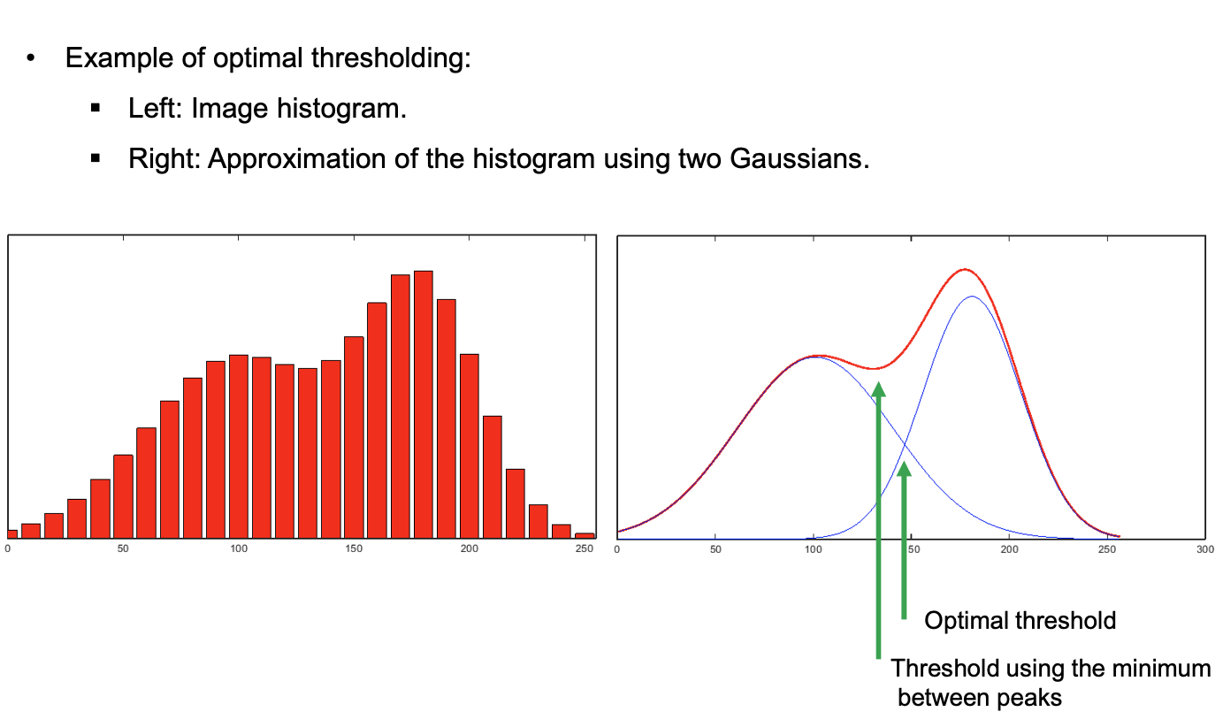
2.4. Optimal thresholding

Slide 29
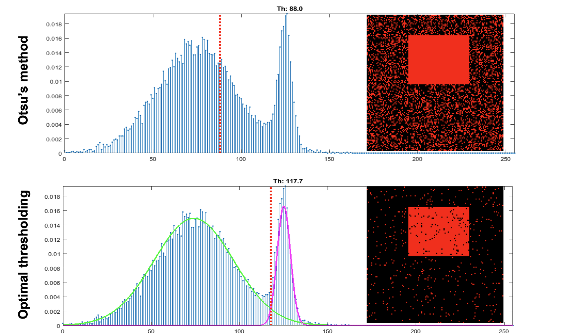
2.4. Optimal thresholding

Slide 30
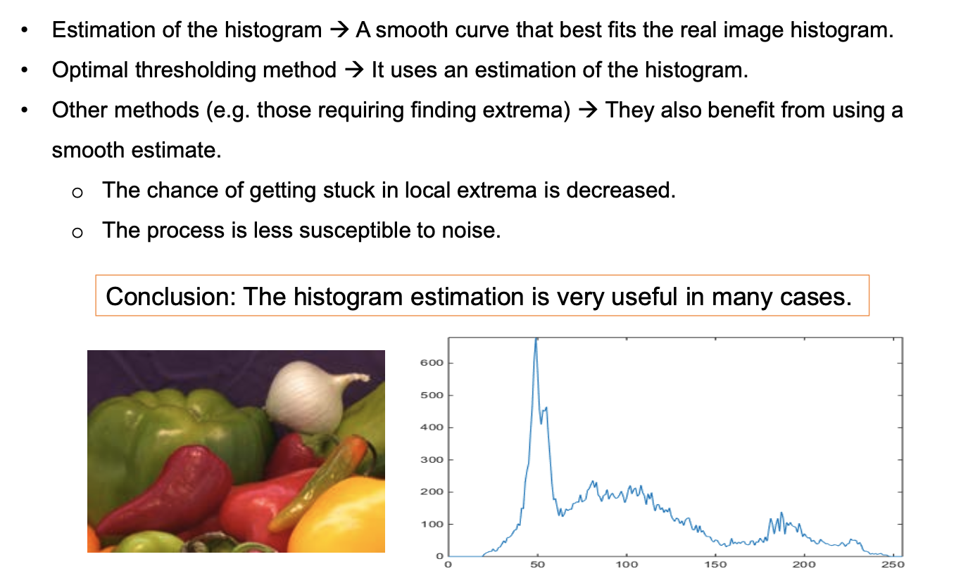
2.5. Histogram estimation

Slide 31
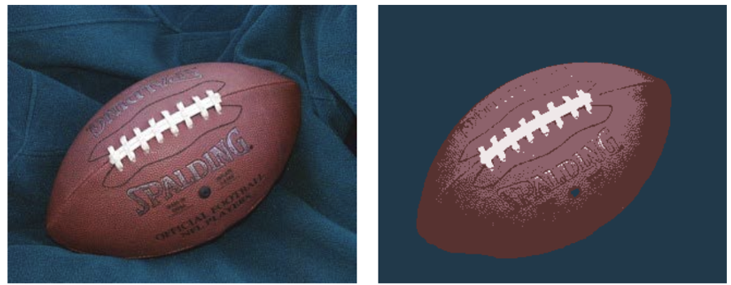
2.5. Histogram estimation

Slide 32
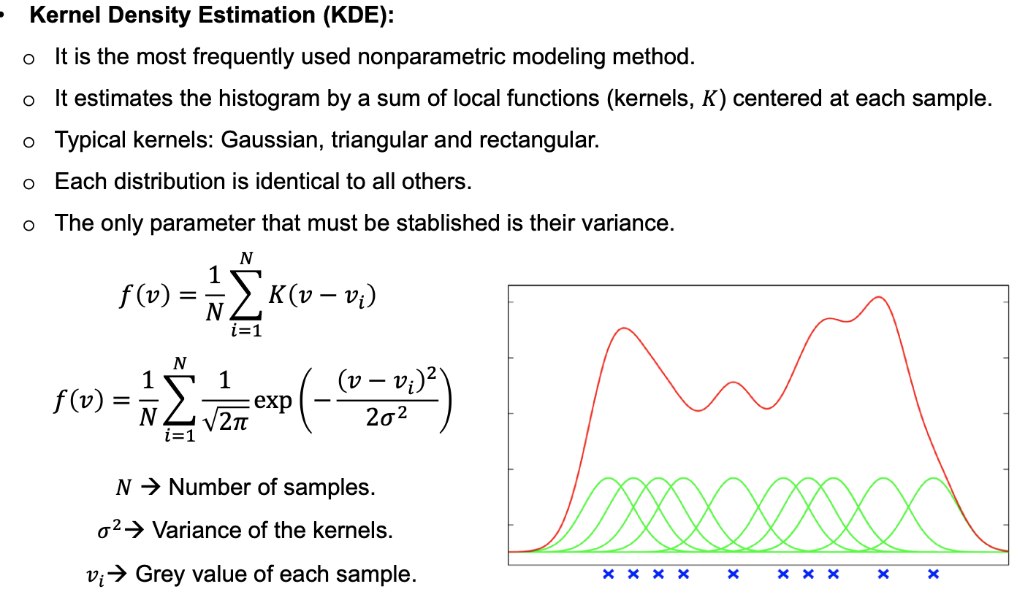
2.5. Histogram estimation

Slide 33
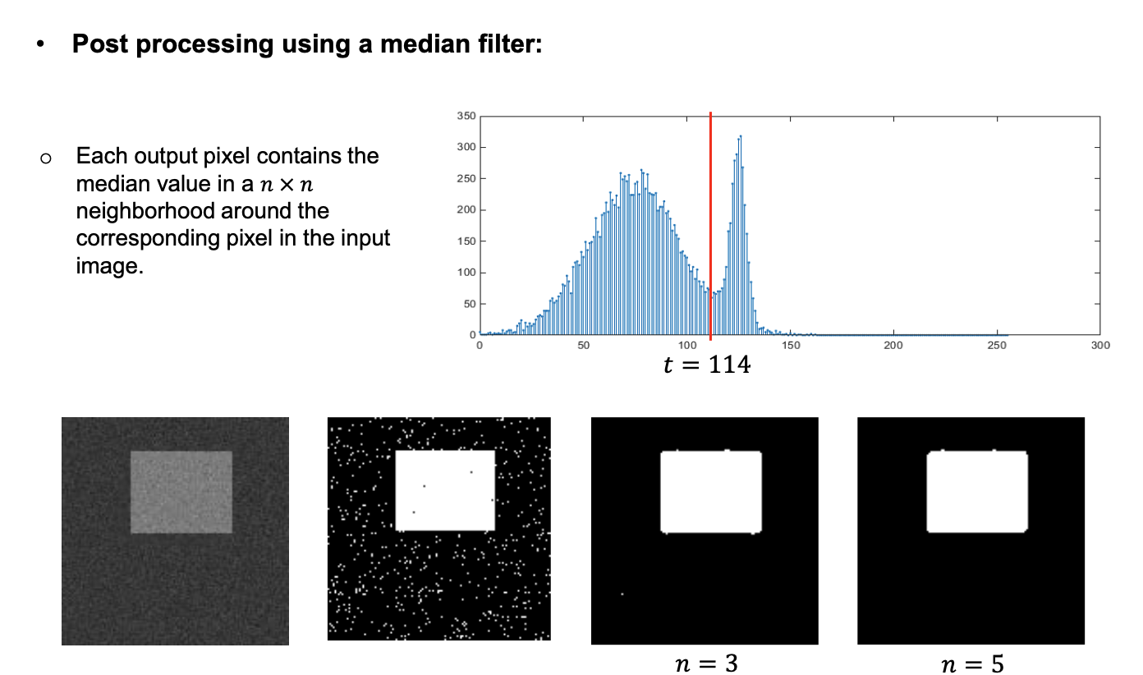
2.6. Enhancing threshold segmentation

Slide 34
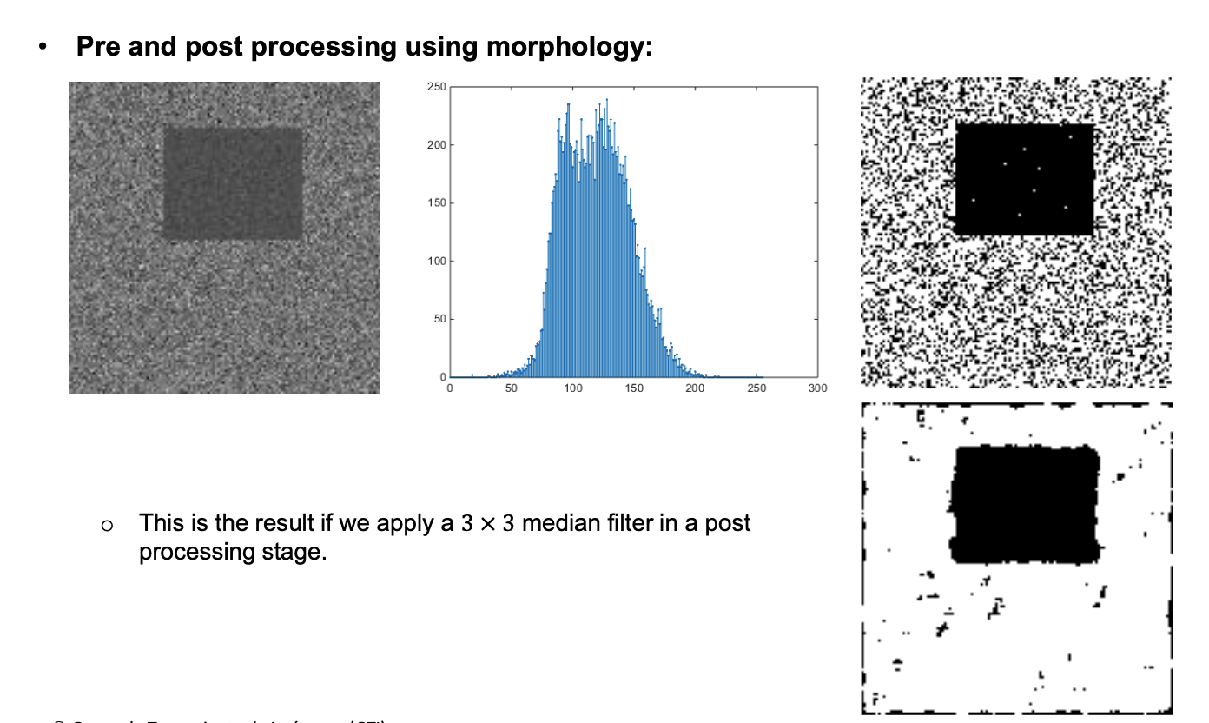
2.6. Enhancing threshold segmentation

Slide 35
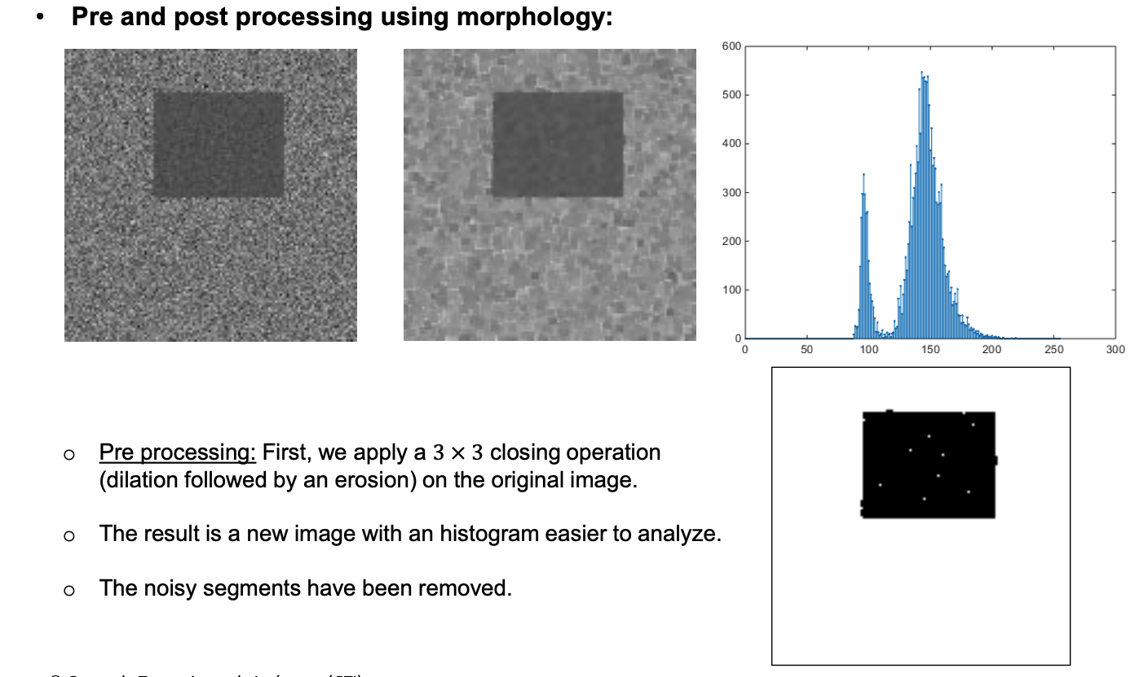
2.6. Enhancing threshold segmentation

Slide 36
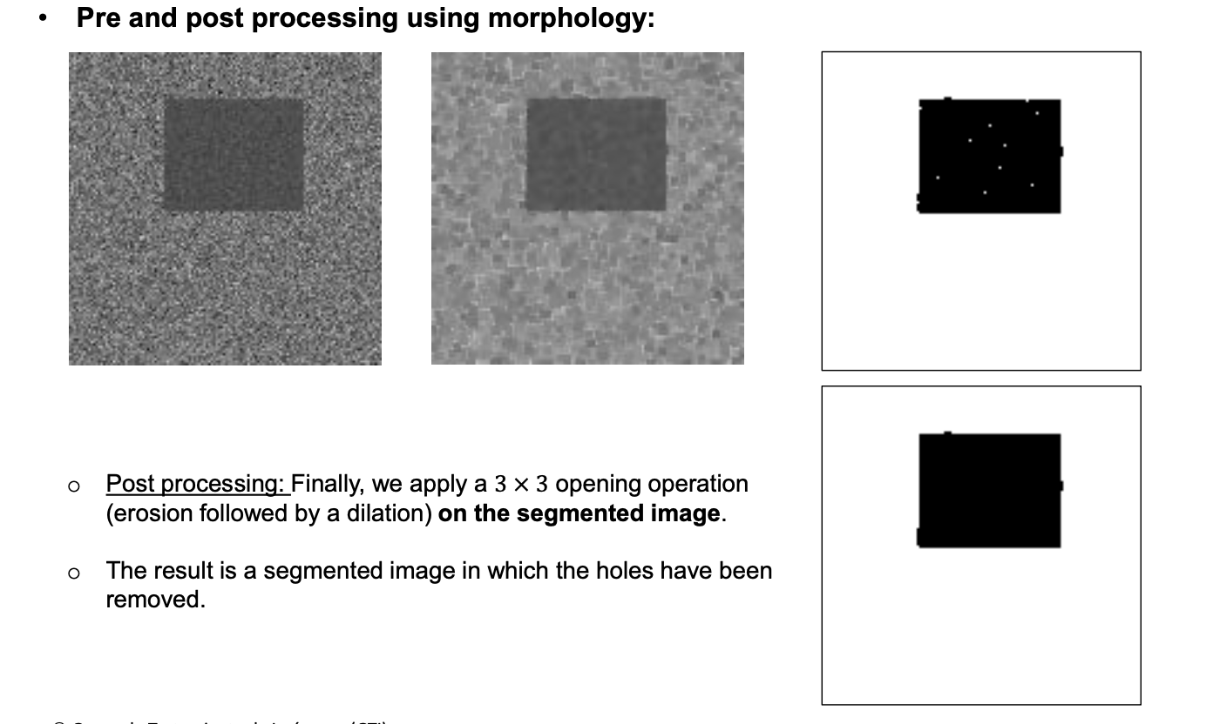
2.6. Enhancing threshold segmentation

Slide 37
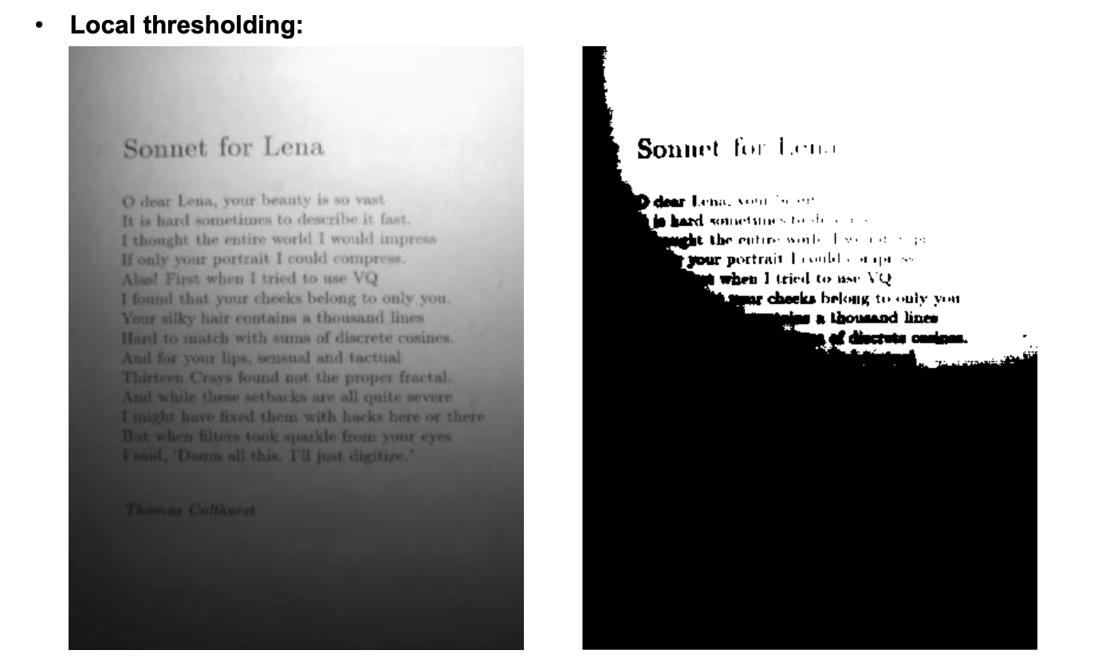
2.6. Enhancing threshold segmentation

Slide 38
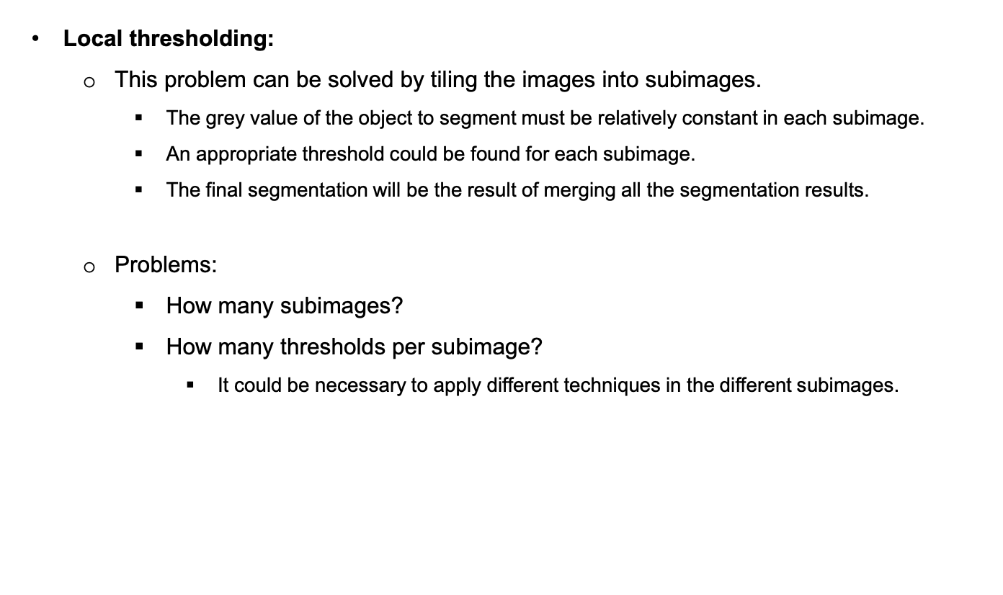
2.6. Enhancing threshold segmentation

Slide 39
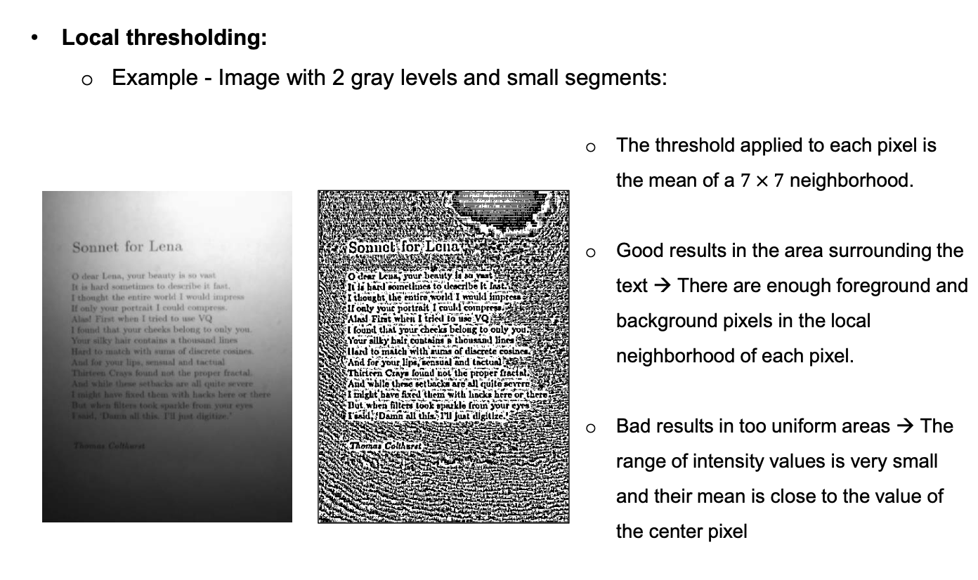
2.6. Enhancing threshold segmentation

Slide 40
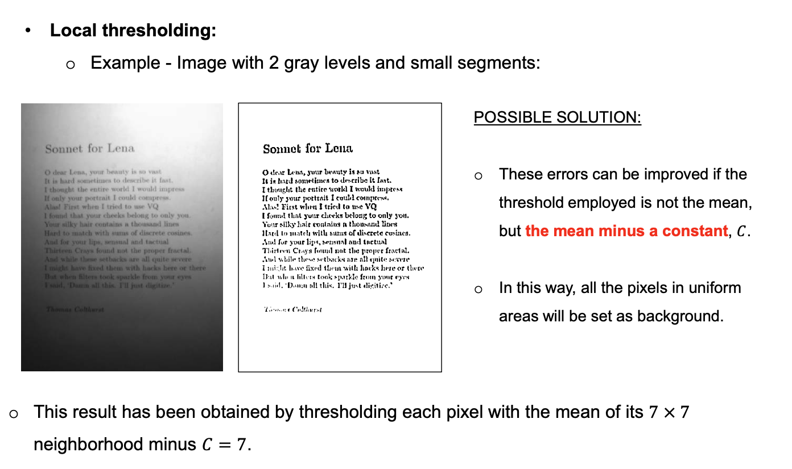
2.6. Enhancing threshold segmentation

Slide 41
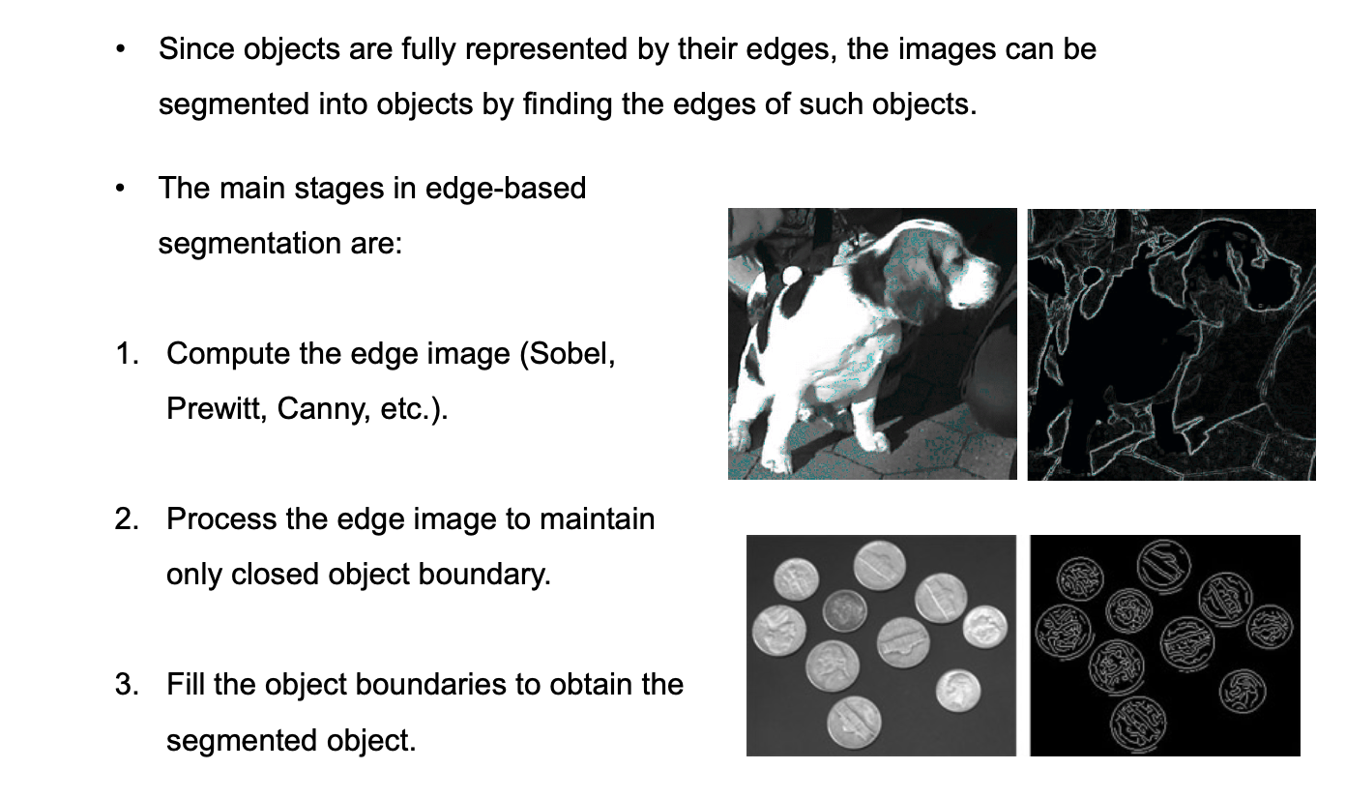
3. Edge-based segmentation

Slide 42
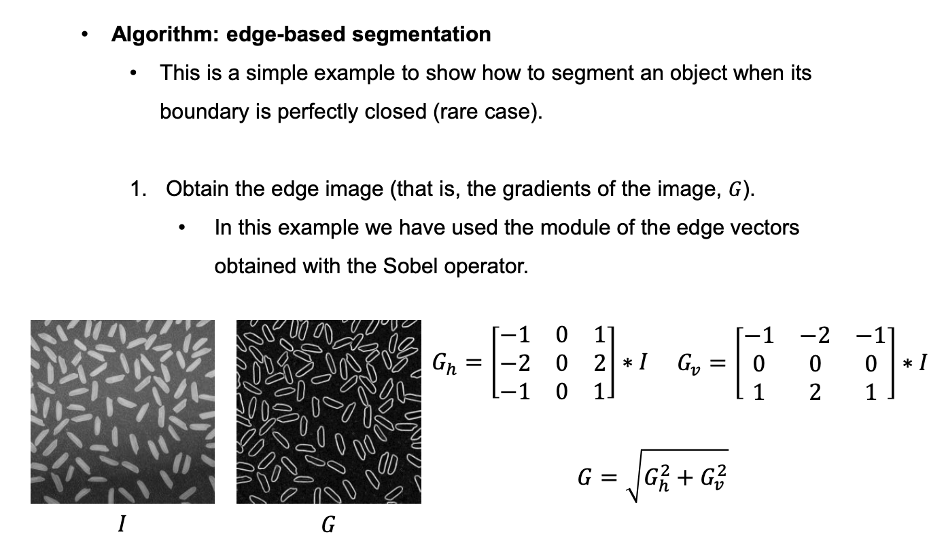
3. Edge-based segmentation

Slide 43
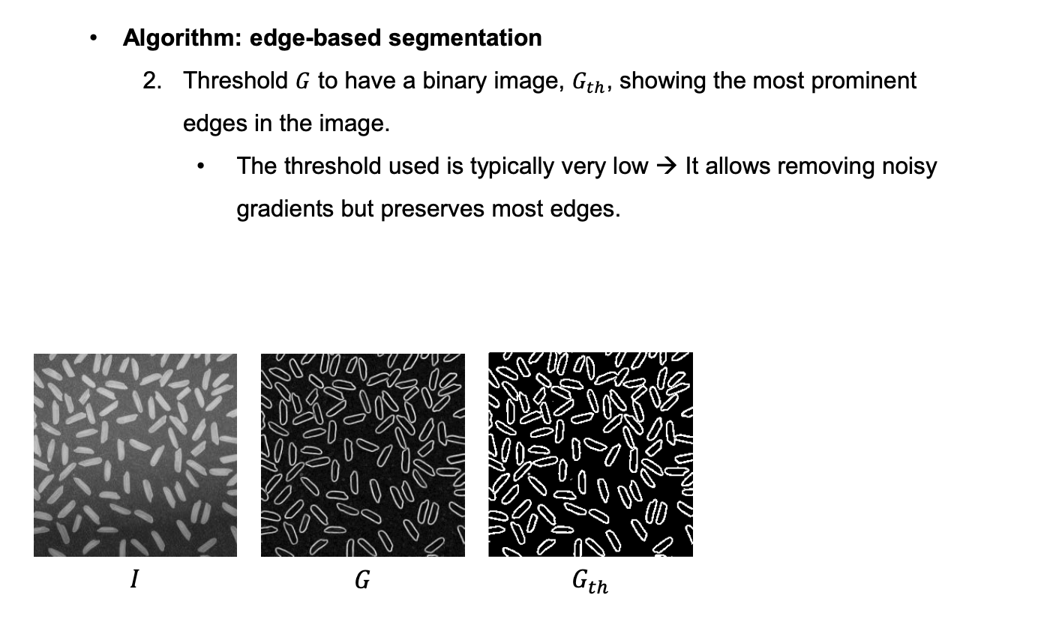
3. Edge-based segmentation

Slide 44
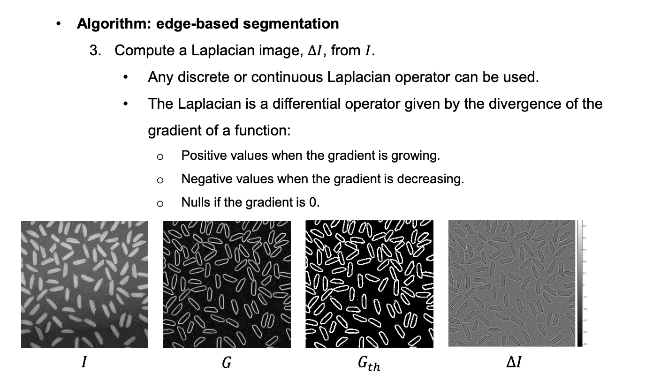
3. Edge-based segmentation

Slide 45
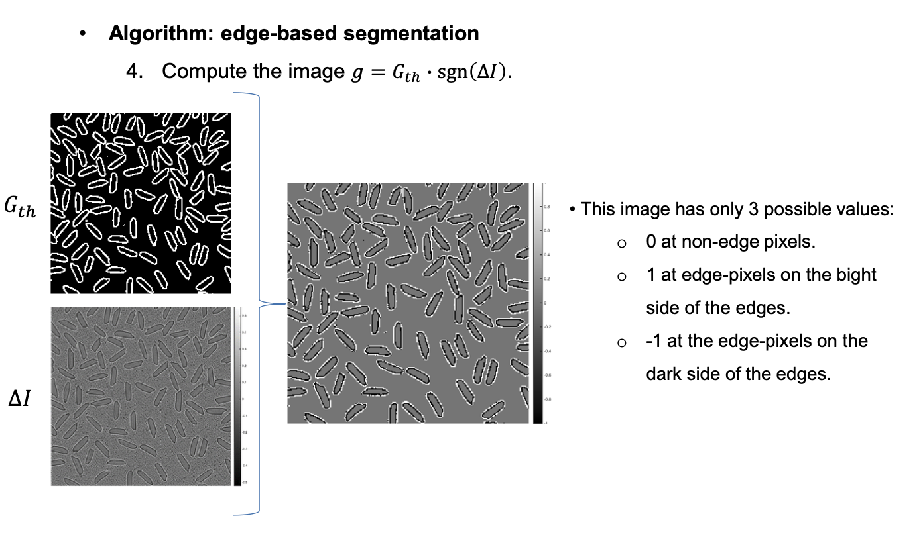
3. Edge-based segmentation

Slide 46
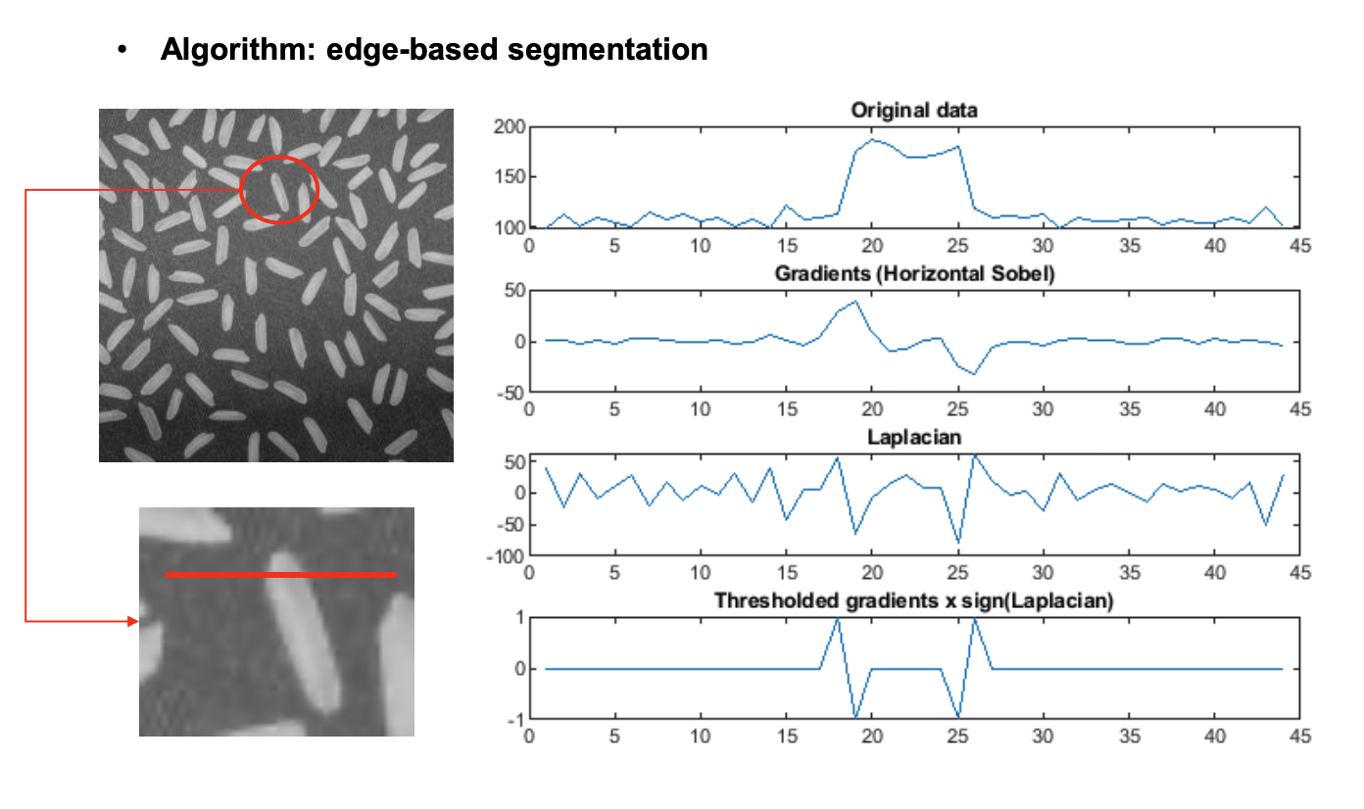
3. Edge-based segmentation

Slide 47
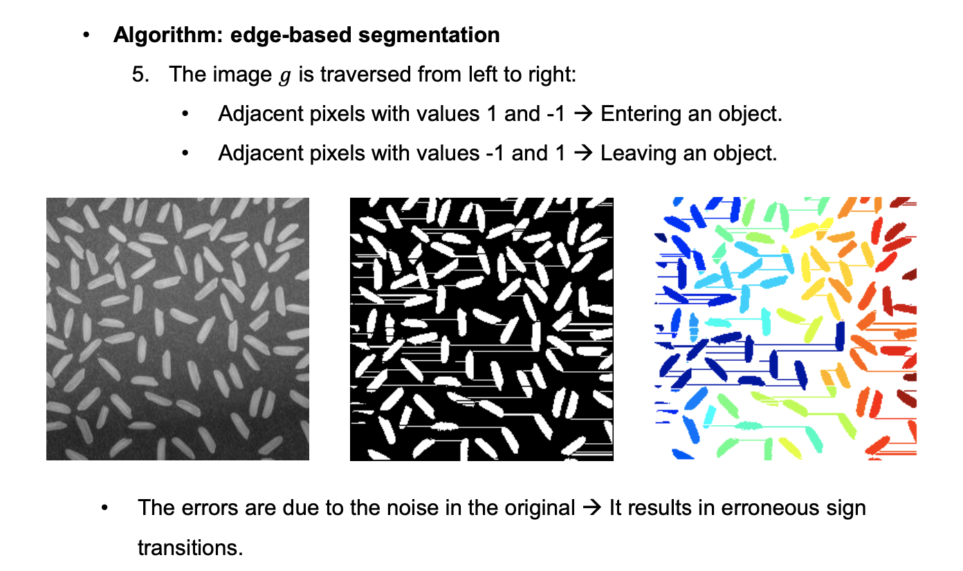
3. Edge-based segmentation

Slide 48
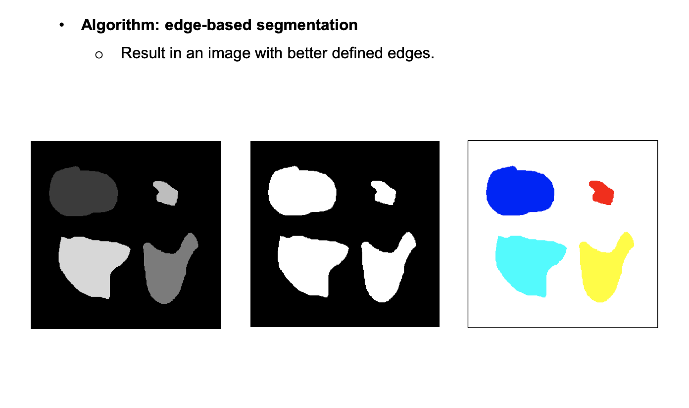
3. Edge-based segmentation

Slide 49
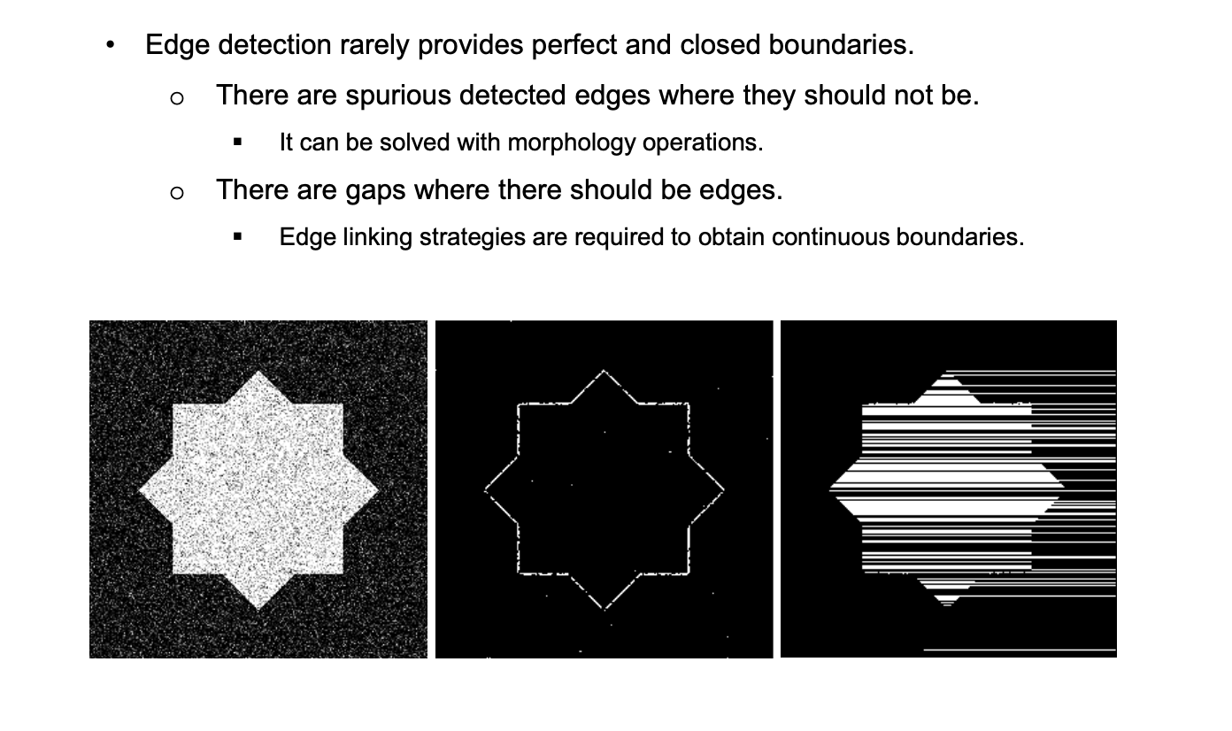
3.1. Edge linking

Slide 50
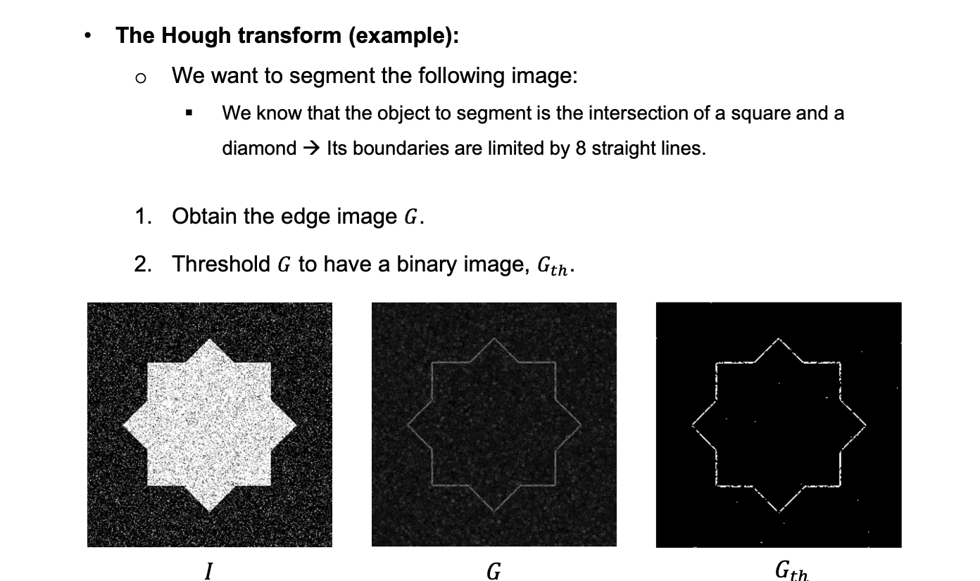
3.1. Edge linking

Slide 51

3.1. Edge linking

Slide 52

3.1. Edge linking

Slide 53

3.1. Edge linking

Slide 54

3.2. Watershed segmentation
“heatmap” – distance transform
watershed
connected components
https://www.youtube.com/watch?v=3MUxPn3uKSk

Slide 55

3.2. Watershed segmentation
https://www.youtube.com/watch?v=3MUxPn3uKSk

Slide 56

3.3. Active contours

